Slide 1

Meta Reinforcement Learning with Active Domain Randomization for Sim-to-Real Transfer
Thesis Progress Presentation

Slide 2
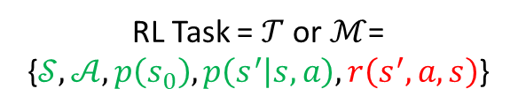
Intro & Background
RL: train an agent to act optimally given a task
Often: Real physical robot
(RL is A.I.’s approach to control of robots)
Mainly: w.r.t. rewards
(performance)
Other Evaluation metrics:
Data/sample efficiency
Learning speed
Generalization
Safety
etc
RL Task = $𝒯$ or $ℳ$= {$𝒮,𝒜, p\left(s_{0}\right), p\left(s^{′} | s,a\right),r\left(s^{′},a,s\right)$}
Environment
Reward
Agent
s
r
a
Environment

Slide 3
Motivation & Problem
Ultimate objective: deploying the trained controller/policy on the real robot
Main evaluation metric: Performance
Problem: Sim-to-Real Transfer
Use of simulators for training as training on real agents directly might be not possible or real data collection could be expensive and RL is data hungry.
Refers to the gap between simulation models and real systems due to deficiencies in models or mismatch of parameter values
Problem: improving performance of learned policies for Sim2Real transfer. (affecting the “Environment” component of RL task)

Slide 4
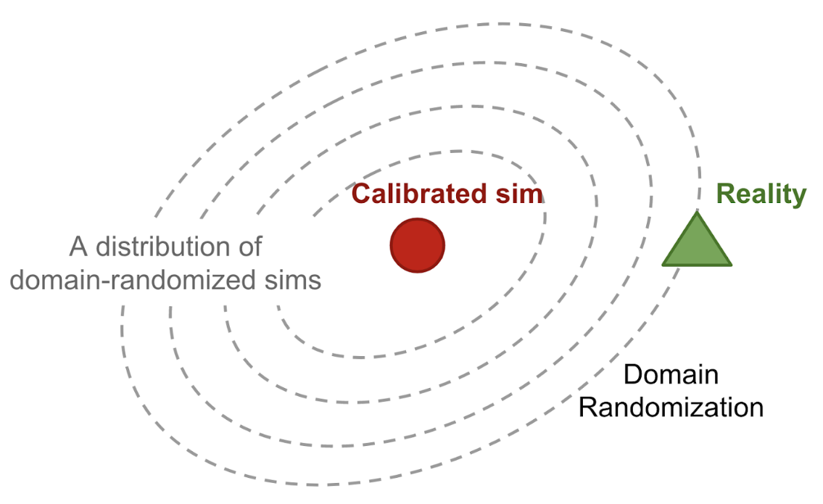
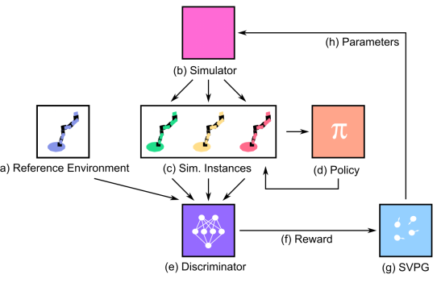
Methods
1- Domain Randomization:
Train [robust policies] in environments with parameters sampled from ranges
Example: Active Domain Randomization (ADR)
Mehta, B., Diaz, M., Golemo, F., Pal, C.J., & Paull, L. (2019). Active Domain Randomization. CoRL.
Choice of what parameters to vary
Sampling Strategy
(e.g. Uniform – UDR)
How to define them
Image Source: https://lilianweng.github.io/lil-log/2019/05/05/domain-randomization.html

Slide 5
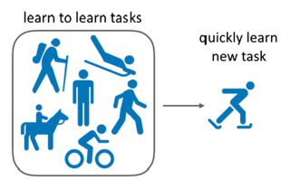
Methods
2- Meta-Learning (Learning how to learn):
Intuition about an issue with traditional DR: Robustness could sometimes come at the cost of performance (i.e. a “universal” policy might be inferior to one that can adapt to the current context)
Meta-RL is one way to train adaptive policies. Distilled knowledge from prior experience (by training on a set of meta-training tasks) could be leveraged to adapt quickly to new downstream tasks (drawn from the same distribution). This knowledge is in the form of meta-parameters (e.g. priors over the learned policy).

Slide 6
Research Questions
1- Main Objectives:
1- Meta-RL so far has relied on uniform sampling from task distribution (including, uniform domain randomization (UDR)). Would combining meta-RL with active domain randomization (ADR) instead yield better performance over the randomization ranges and/or generalization of the meta-RL algorithm in the setting of changing dynamics and fixed rewards?
Hypothesis: Since ADR establishes some notion of a curriculum in sampling from the randomization domain and that it has been shown to be superior to UDR when both use a standard/core RL algorithm, combining meta-RL with ADR instead of UDR will also yield similar improvements to the meta-RL algorithm in terms of its performance over the randomization ranges and generalization in the setting of changing dynamics and fixed rewards.
2- Active domain randomization so far has been used with standard/core RL algorithms to train a robust policy. Would combining it with a meta-RL algorithm instead, to train an adaptable policy, yield better performance over the randomization ranges and/or generalization in the setting of changing dynamics and fixed rewards?
Hypothesis: Adaptive policies (learned by meta-RL algorithms) are at least as good as, and in many cases superior to, robust policies (learned by standard RL-algorithms) in terms of performance over the randomization ranges in the setting of changing dynamics and fixed rewards, since the meta-parameters of the meta-RL algorithms could be seen as comparable to the robust policies’ parameters, but additionally the perform a fine-tuning step to adapt to the current context which would yield better performance.

Slide 7
Research Questions
2- Stretch Objectives:
1- In the setting of changing dynamics and fixed rewards, so far, the meta-RL algorithms have been model-based. Would using a model-free meta-RL algorithm yield comparable results in terms of performance and generalization?
Hypothesis: Since the [optimal] policy is affected by changing dynamics, policy-based/model-free meta-RL algorithms would produce a comparable performance over the randomization ranges and generalization to model-based meta-RL algorithms in the setting of changing dynamics and fixed rewards.

Slide 8
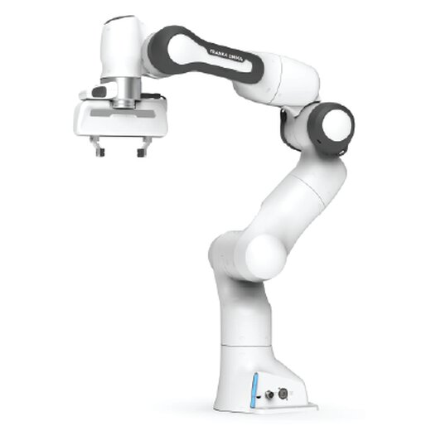
Experiments
1- Setup / Plan:
Sim2Sim (Mujoco Envs) |  | Sim2Real
1- Hopper Joint damping Ground Friction | 2- HalfCheetah Links sizes Motor torques | Franka Panda 1- Sim2Sim 2- Sim2Real

Slide 9
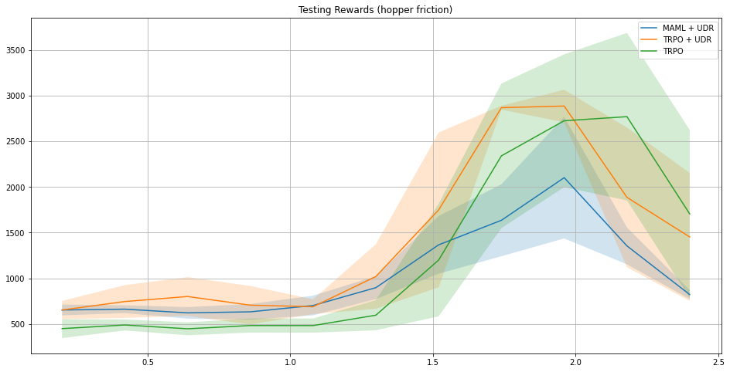
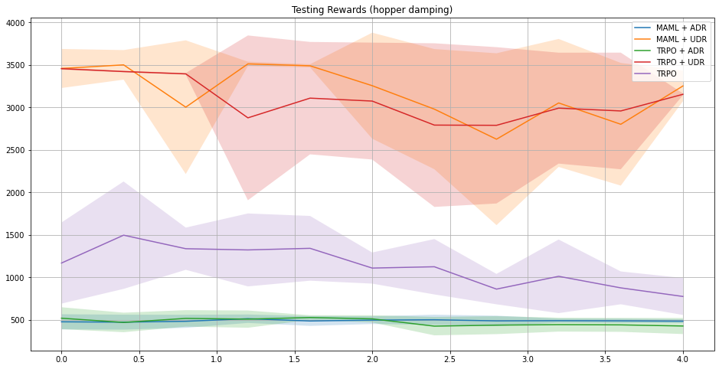
Experiments
2- Example of some results so far:

Slide 10
Workplan & Progress
Desired/Estimated end date: 1/5/2022
Phase | Steps | Details | Status
Thesis Work | Literature Review | Excel Sheet detailing reviewed papers and choosing ones of interest | Done
 | Implement Meta-RL | MAML algorithm | Done
 | Implement Domain Randomization (DR) | UDR & ADR | Done
 | Milestone 1: Combine Meta-RL + DR | MAML + ADR/UDR | Done
 | Milestone 2: Run Sim2Sim Experiments | Experiments with algorithms on Mujoco envs with varying dynamics | In Progress
 | Run Sim2Sim experiments on simulation of real test env | - | Not started
 | Milestone 3: Run Sim2Real Experiments | Experiments with algorithms on real robot env with varying dynamics | Not started
Thesis Finalization | Write Thesis Document & Prepare Presentation | - | Not started

Slide 11
Resources
Repositories:
Main: https://github.com/Tarek-Ibrahim/msc-thesis
Custom Environments: https://github.com/Tarek-Ibrahim/gym-custom (installed with: pip install –e gym_custom from parent dir)
Overleaf document:
https://www.overleaf.com/read/ptyzrrjwdznd

